Slide 1
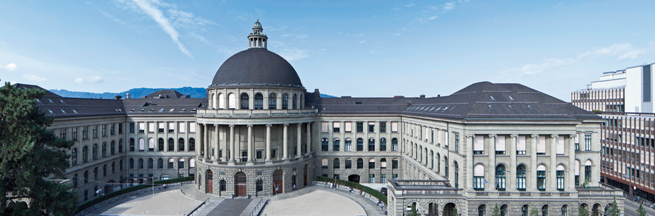
Analysis of Fish Guidance Structures in Downstream Migration
Group 9: Beck, Elliot; Fuentes, Eufemiano; Park, Jun

Slide 2
Index
Recap of the topic
The design of the experiment
Simulations and results

Slide 3
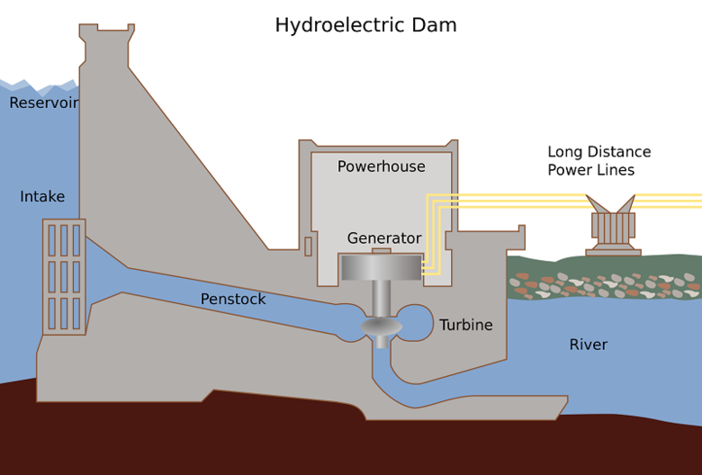
1. Recap of the topic
What are Fish Guidance Structures?

Slide 4
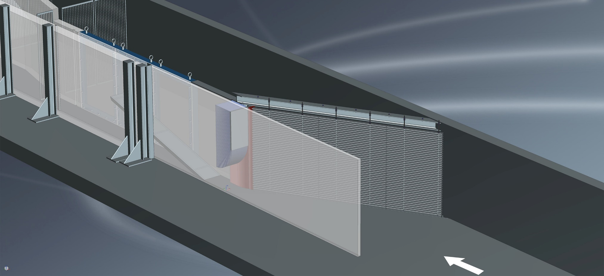
1. Recap of the topic
What are Fish Guidance Structures?

Slide 5
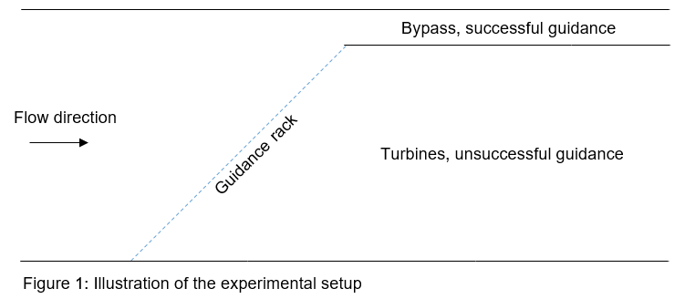
1. Recap of the topic

Slide 6
1. Recap of the topic
How will the experiment be conducted?
2 different guidance structures (vertical and horizontal)
3 different bypass configurations
5 different fish species
3 fish simultaneously
When and where will the experiment take place?
Autumn 2018 and Spring 2019
Laboratory of Hydraulics, Hydrology and Glaciology (ETH Hönggerberg)

Slide 7
1. Recap of the topic
Restrictions of the experiment
Rack and bypass configurations can only be changed daily
Maximum of 70-80 days available
2 seasons, different species per season
Limited storage capacity of fish in the Lab

Slide 8
2. The design of the experiment
Live-fish experiments are extremely time consuming
Objective: to obtain the smallest number of fish (sample size) such that the results are significant
Tradeoffs
The higher the precision to detect differences, the larger the required sample size
The more parameters included in the model, the larger the required sample size

Slide 9
2. The design of the experiment
AUTUMN
SPRING
DAY 1
(R2 & B3)
DAY 2
(R1 & B1)
DAY 30
DAY 1
DAY 2
DAY 30
FS 2
FS 5
FS 1
FS 3
FS 4
FS 4
FS 1
FS 6
FS 2
FS 3
1
2
3
1
2
3
CORRELATED!

Slide 10
2. The design of the experiment
Incomplete design: 2 seasons with different fish species, some overlap
Split-plot design: each day is a whole plot, experiments conducted the same day share same whole plot error
Complete Randomized Design at whole plot level (day) with rack and bypass.
Each day one group per fish species (5 split plots)

Slide 11

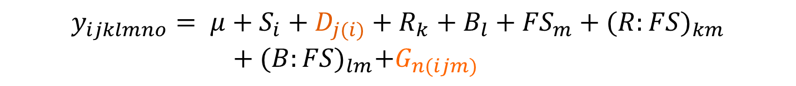

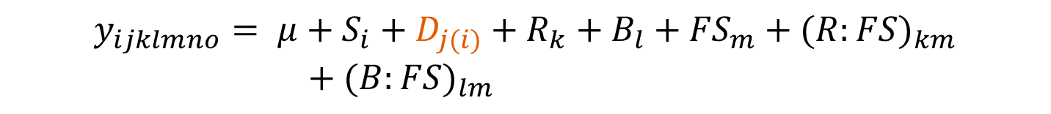

2. The design of the experiment
Full model equation:
$$y_{ijklmno}= μ$$
y : binary response
S : Season (fixed)
D : Day (random)
R : Rack (fixed)
B : Bypass (fixed)
FS : Fish Species (fixed)
G : Group (random)
$$y_{ijklmno}= μ+S_{i}+D_{j(i)}$$
$$y_{ijklmno}= μ+S_{i}+D_{j(i)}+R_{k}+B_{l}+{FS}_{m}$$
$$y_{ijklmno}= μ+S_{i}+D_{j(i)}+R_{k}+B_{l}+{FS}_{m}+{(R:FS)}_{km}$$
$$+ {(B:FS)}_{lm}+G_{n(ijm)}$$
$$y_{ijklmno}= μ+S_{i}+D_{j(i)}+R_{k}+B_{l}+{FS}_{m}+{(R:FS)}_{km}$$
$$+{ (B:FS)}_{lm}$$
$$y_{ijklmno}= μ+S_{i}$$
A
S

Slide 12
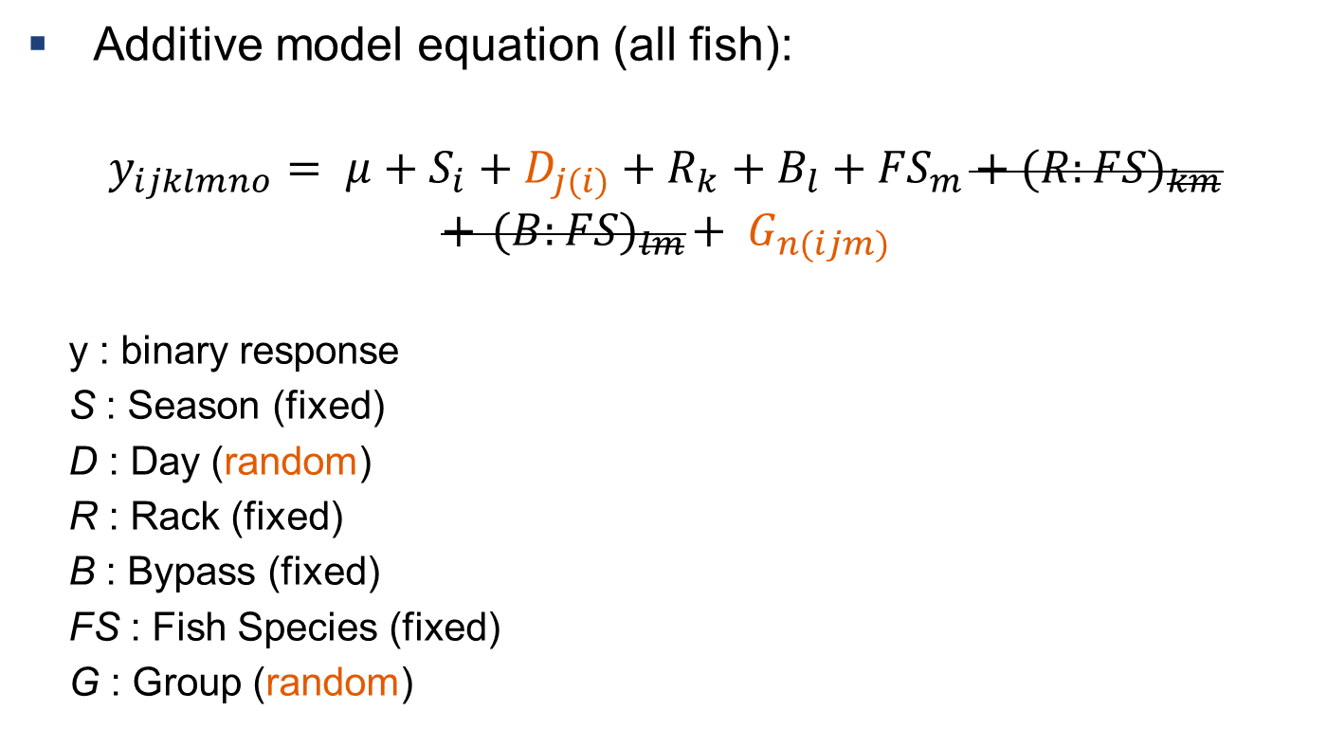
2. The design of the experiment
Additive model equation (all fish):
$$y_{ijklmno}= μ+S_{i}+D_{j(i)}+R_{k}+B_{l}+{FS}_{m}+{(R:FS)}_{km}$$
$$+{ (B:FS)}_{lm}+ G_{n(ijm)}$$
y : binary response
S : Season (fixed)
D : Day (random)
R : Rack (fixed)
B : Bypass (fixed)
FS : Fish Species (fixed)
G : Group (random)
p-values for Rack and Bypass effects using LRT
A
S

Slide 13
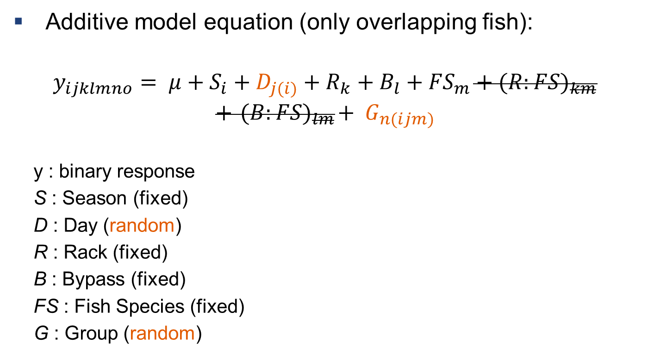
2. The design of the experiment
Additive model equation (only overlapping fish):
$$y_{ijklmno}= μ+S_{i}+D_{j(i)}+R_{k}+B_{l}+{FS}_{m}+{(R:FS)}_{km}$$
$$+{ (B:FS)}_{lm}+ G_{n(ijm)}$$
y : binary response
S : Season (fixed)
D : Day (random)
R : Rack (fixed)
B : Bypass (fixed)
FS : Fish Species (fixed)
G : Group (random)
p-values for Fish Species effect using LRT
A
S

Slide 14
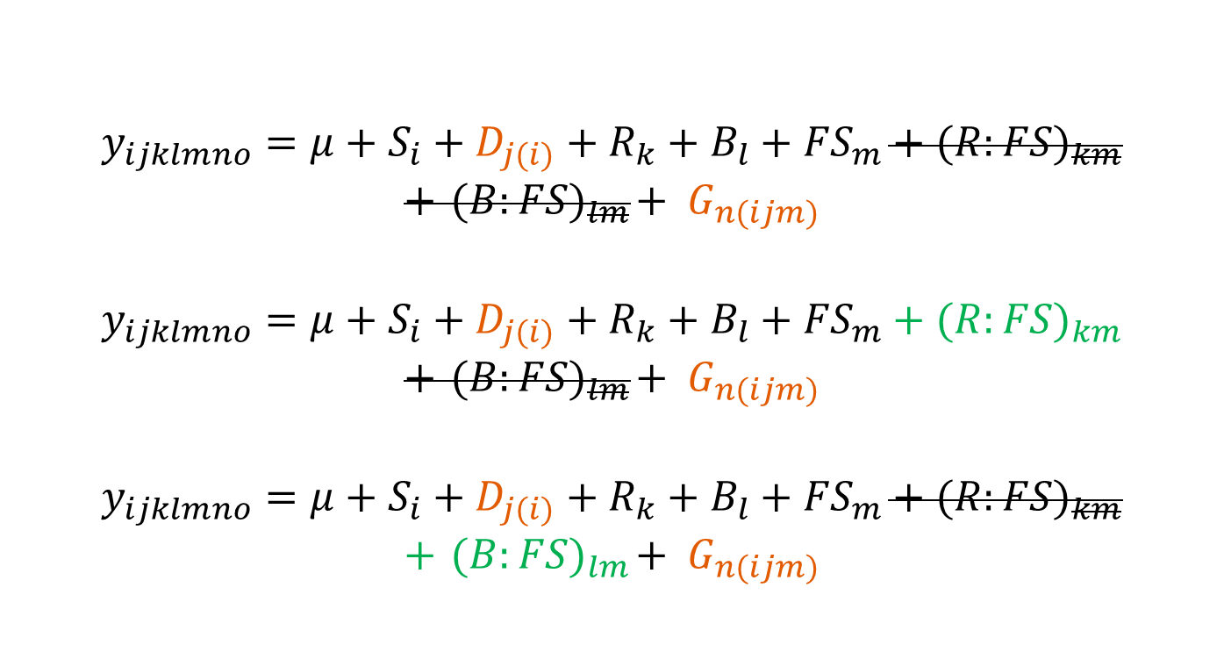
2. The design of the experiment
Models with interaction terms (overlapping fish):
$$y_{ijklmno}=μ+S_{i}+D_{j(i)}+R_{k}+B_{l}+{FS}_{m}+{(R:FS)}_{km}$$
$$+{ (B:FS)}_{lm}+ G_{n(ijm)}$$
$$y_{ijklmno}=μ+S_{i}+D_{j(i)}+R_{k}+B_{l}+{FS}_{m}+{(R:FS)}_{km}$$
$$+{ (B:FS)}_{lm}+ G_{n(ijm)}$$
$$y_{ijklmno}=μ+S_{i}+D_{j(i)}+R_{k}+B_{l}+{FS}_{m}+{(R:FS)}_{km}$$
$$+{ (B:FS)}_{lm}+ G_{n(ijm)}$$
Base:
Nested 1:
Nested 2:

Slide 15
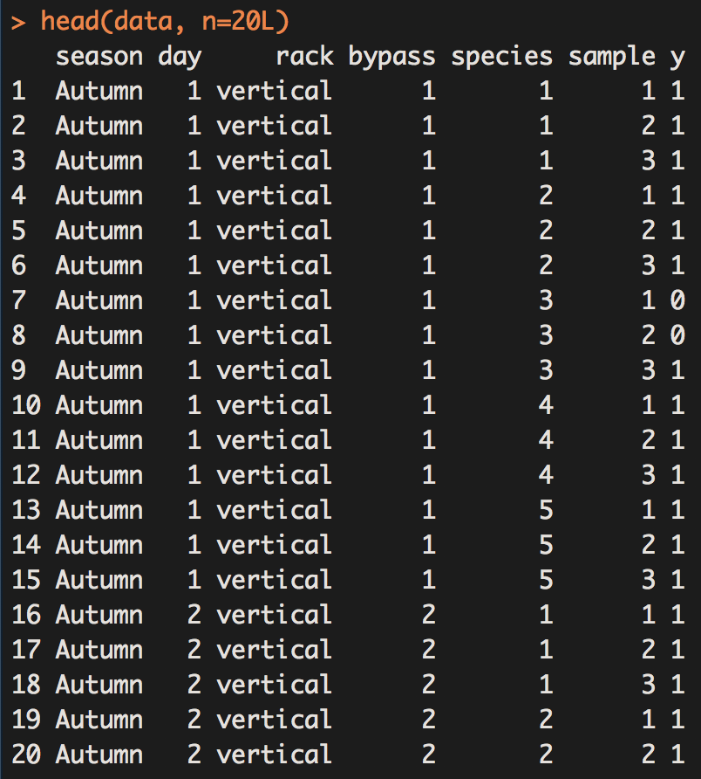
3. Simulations and results
No observational data available
We created simulated data instead
Fish within groups are not independent
We used expert knowledge to estimate the inter group correlations
rmvbind was then used to create binary data

Slide 16
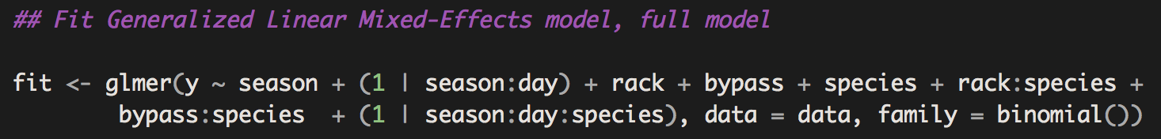
3. Simulations and results
We used the glmer function to fit the model
drop1 and anova were used for hypothesis testing
For each n and for each difference we simulated 300 times
Power is the rejection rate of the 300 tests

Slide 17
3. Simulations and results

Slide 18
3. Simulations and results

Slide 19
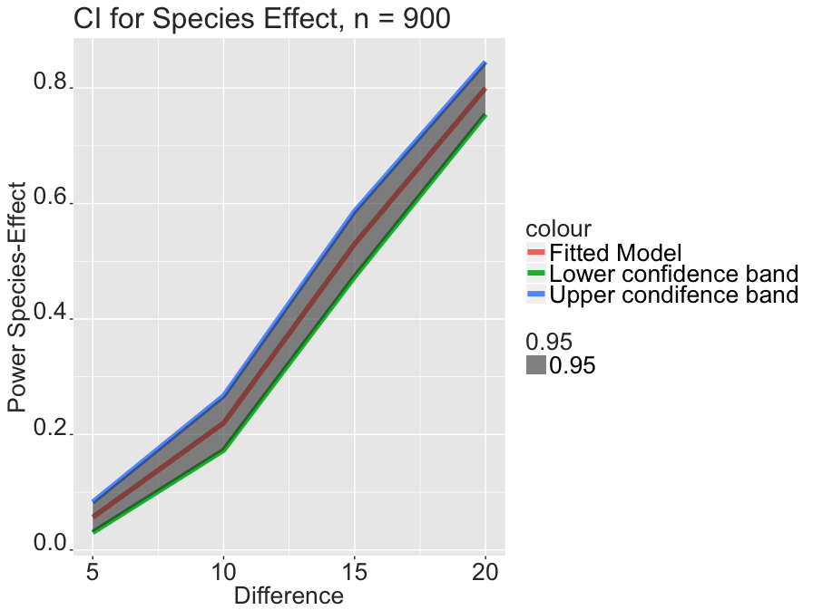
3. Simulations and results

Slide 20
3. Simulations and results

Slide 21
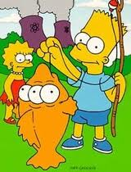
Thanks for your attention!

